Slide 1
Computational analysis of SARS-CoV-2 surface glycoprotein sequence to determine biological consequences of sequence evolutionary patterns
Team SARS:
Michael Phung
Lavang Vu
Shay Beheshti
Inimary Toby

Slide 2
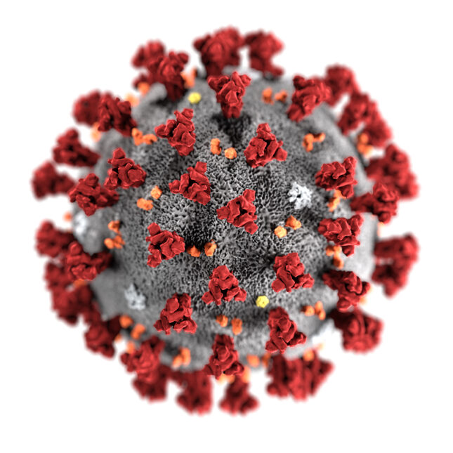
Background
SARS-CoV-2 continues to spread and evolve since its initial outbreak in 2019.
This virus is a +ssRNA virus whose genome contains genetic instructions for the construction of the Spike (S) protein.
The S protein is a 1273 amino acid-long glycoprotein that plays a role in SARS-CoV-2 pathogenesis.

Slide 3
Biological Significance
Understanding variation across SARS-CoV-2 genome sequences and particularly spike protein sequences has important implications for the study of virology and epidemiology.
Implementation of a randomization algorithm for dataset selection, a geographical distribution can be obtained from samples across the United States; This process can subsequently be parallelized to accommodate sample to sample comparisons

Slide 4

3D Visualization of the Spike Glycoprotein Structure of SARS-CoV-2 virus.
Subunit 1 consists of the globular structures of the bottom of the image, and Subunit 2 is the long helical structure that is mostly hydrophobic in order to enter the hydrophobic interior of the cell membrane.

Slide 5
Workflow Steps
Data Analysis and Interpretation
03
Data Selection, Retrieval and Parsing
01
02
Methods Development

Slide 6
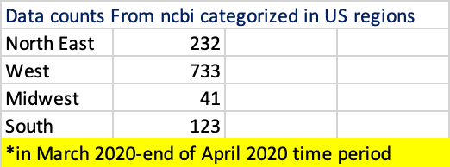

NCBI Data Demographic

Slide 7
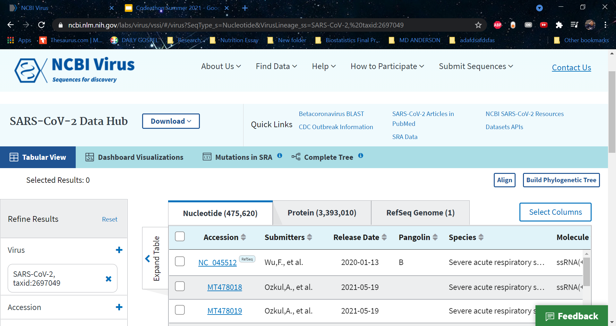
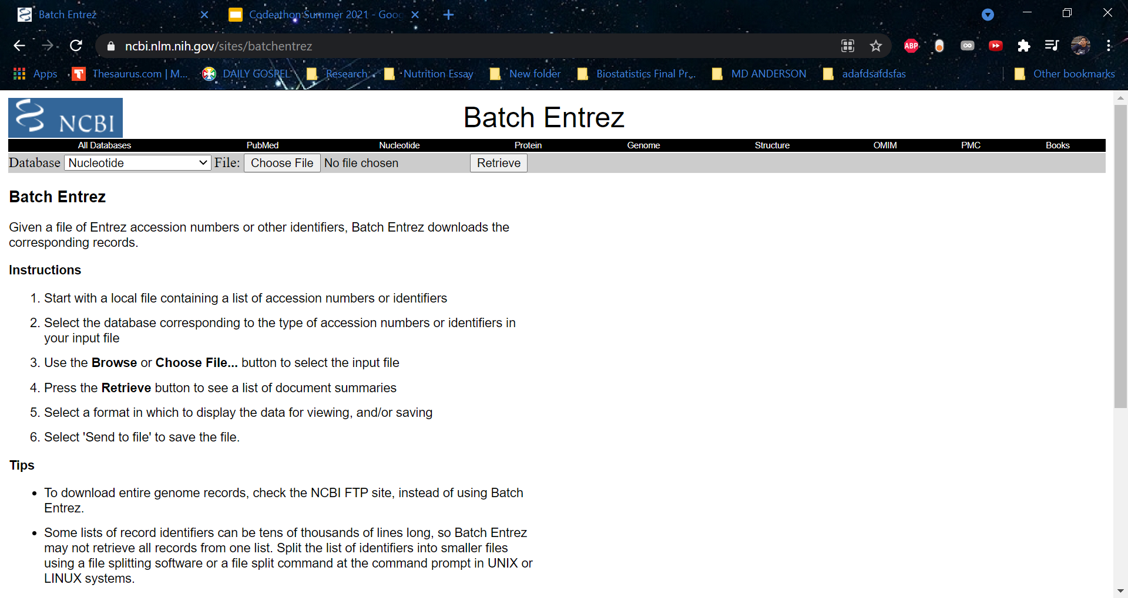
Methods

Slide 8
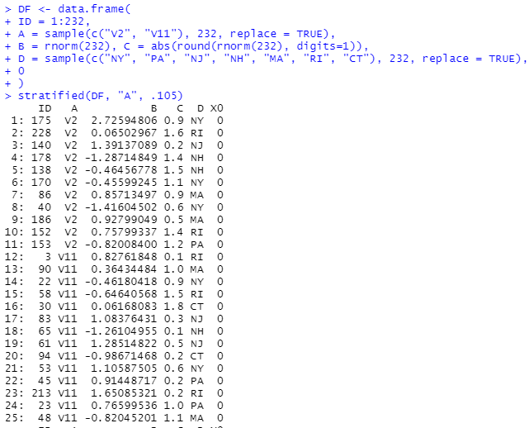
Methods
Code for stratified sampling
Top portion is the parameters
Last blue line is the code for stratified sampling
Output in black; 25 entries

Slide 9
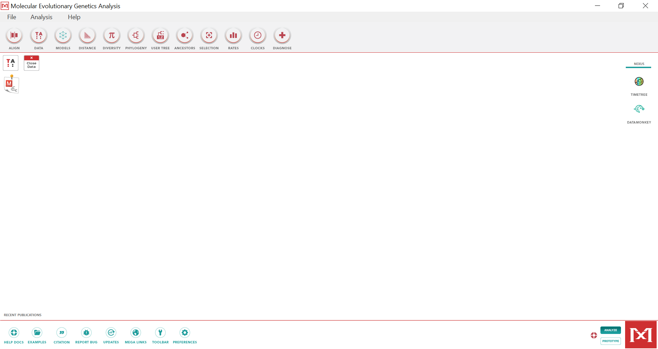
Methods for the Genome/Spike MSA + Phylogenetic Tree via MEGA
Graphic User Interface
The in house tools are Muscle and its own phylogenetic analysis tool.

Slide 10
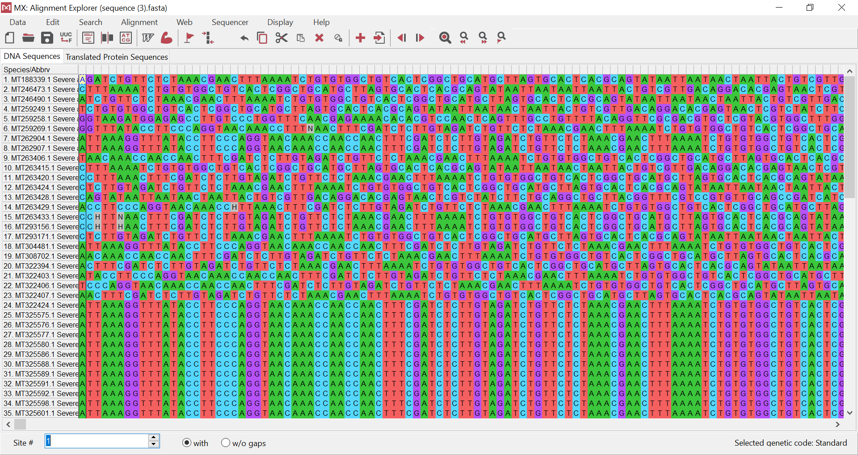
Results for SARS-CoV-2 Whole Genome Analysis

Slide 11
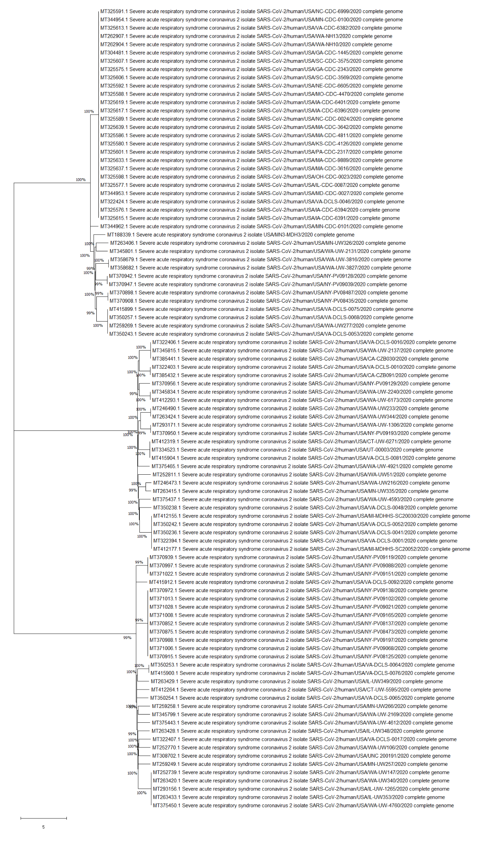
Results

Slide 12
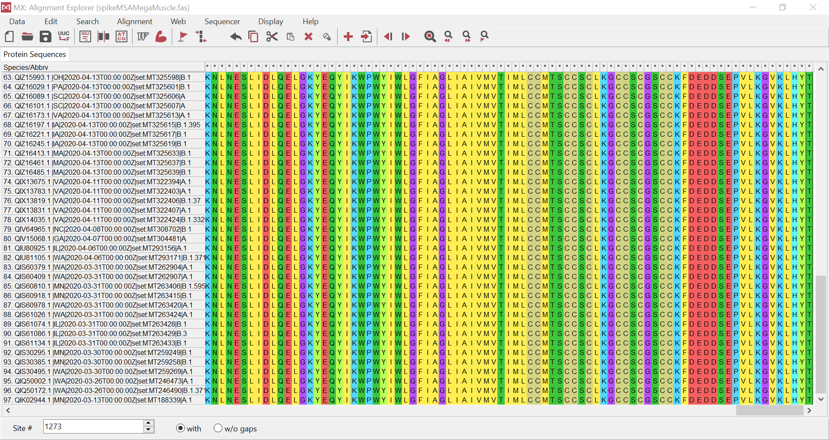
Results for Surface Glycoprotein Analysis

Slide 13
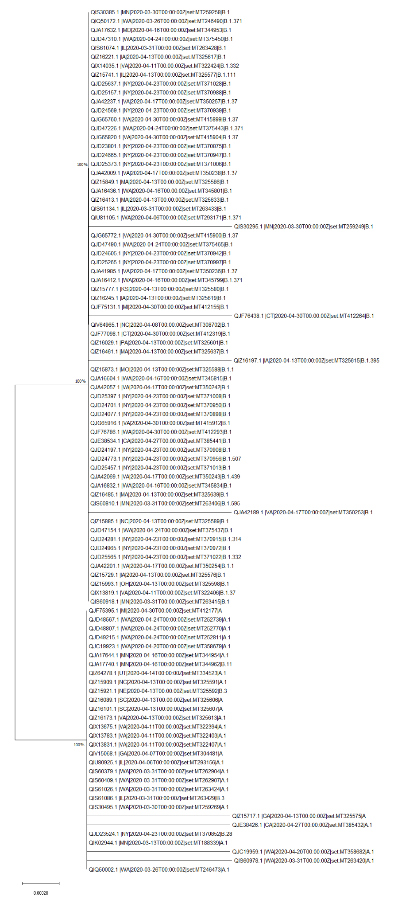
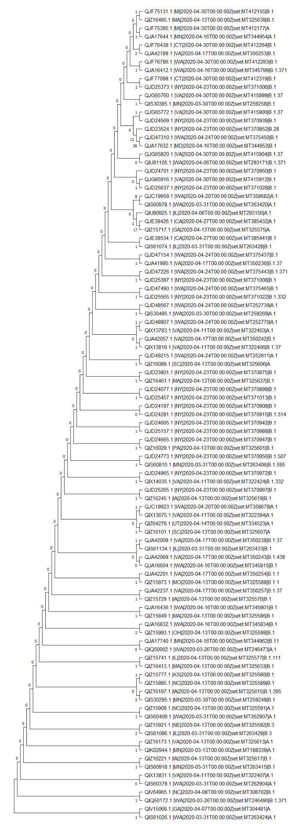
Results for Surface Glycoprotein Phylogenetic Analysis
Original

Slide 14
Discussion
From the Spike protein Phylogenetic Tree and MSA, there are areas of slight differences between the sequences. A detailed analysis of the individual clades would be informative.
The spike protein sequences from this time period are highly conserved.
The implementation of Biopython (or more optimized tools) would help provide faster analysis with shorter wait time.

